Slide 1
Exploring 3D Dynamics in CryoEM– ManifoldEM
Szu-Chi Chung

Slide 2

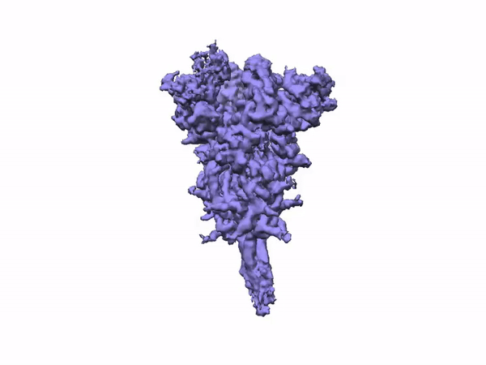
Resolution revolution – Beyond atomic structure [1]
https://cryosparc.com/blog/2019-nCoV
https://www.nature.com/articles/d41586-020-02924-y
Notes:
iron-storing protein called ferritin (termed apoferritin in the absence of metals)

Slide 3
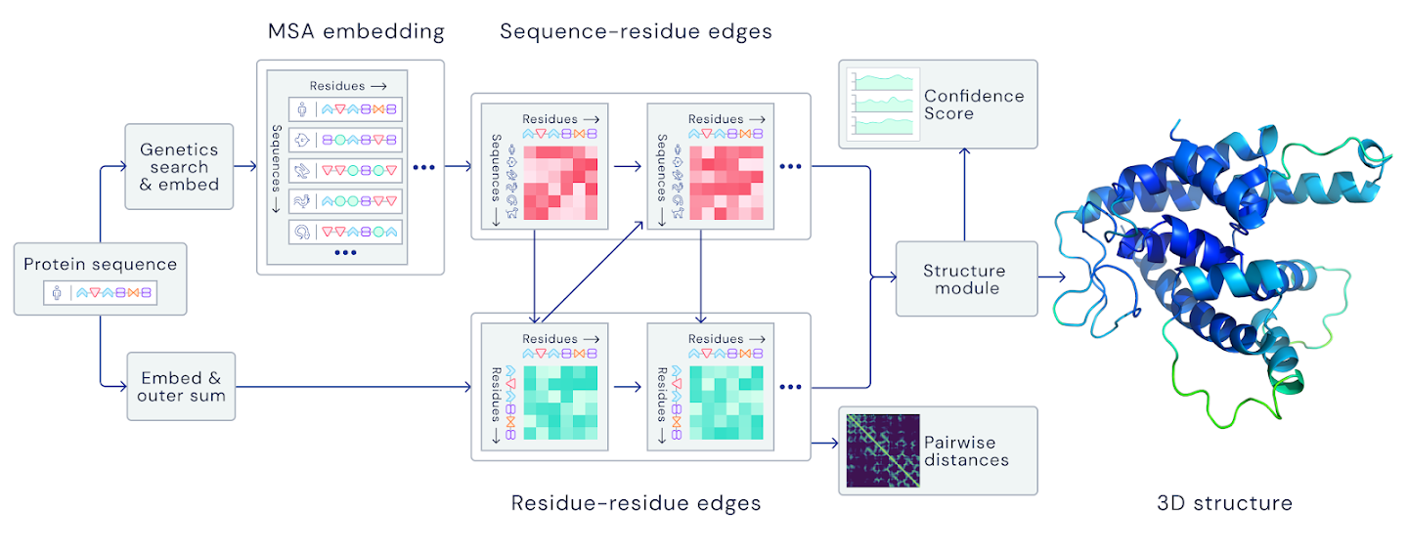
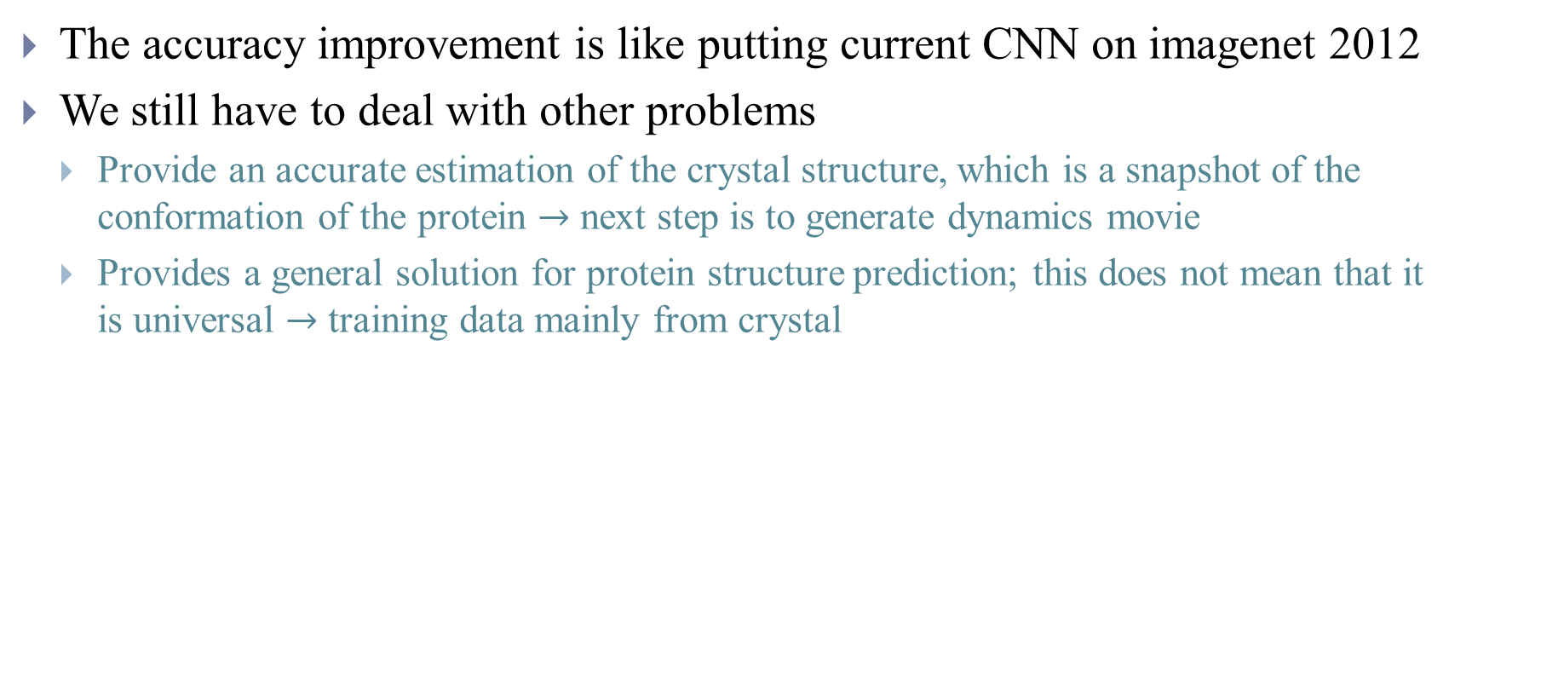
From Structure to Function – After AlphaFold 2 [2-4]
The accuracy improvement is like putting current CNN on imagenet 2012
We still have to deal with other problems
Provide an accurate estimation of the crystal structure, which is a snapshot of the conformation of the protein $→$ next step is to generate dynamics movie
Provides a general solution for protein structure prediction; this does not mean that it is universal $→$ training data mainly from crystal
Notes:
In Situ Structural Biology
Challenging
https://deepmind.com/blog/article/alphafold-a-solution-to-a-50-year-old-grand-challenge-in-biology
https://www.blopig.com/blog/2020/12/casp14-what-google-deepminds-alphafold-2-really-achieved-and-what-it-means-for-protein-folding-biology-and-bioinformatics/
https://moalquraishi.wordpress.com/2020/12/08/alphafold2-casp14-it-feels-like-ones-child-has-left-home/#s4.1
our understanding of the many diseases where misfolding is a cause or a terrible consequence. The success of AlphaFold 2 might provide us with some insight, if we can analyse how the neural network infers the folded structure
Primary structure, Secondary structure
3-4A In situ
But proteins are much more — and the crystal structure doesn’t necessarily tell us the whole story ( The model was trained on the Protein Data Bank, which has a well-known bias towards proteins that are easy to crystallize. )
Furthermore, since AlphaFold takes a multiple sequence alignment as input, it remains to be seen if it can tackle problems where these are shallow or not very informative, as happens for example in the very important problem of protein design, in mutated sequences or sometimes in antibody sequences.

Slide 4
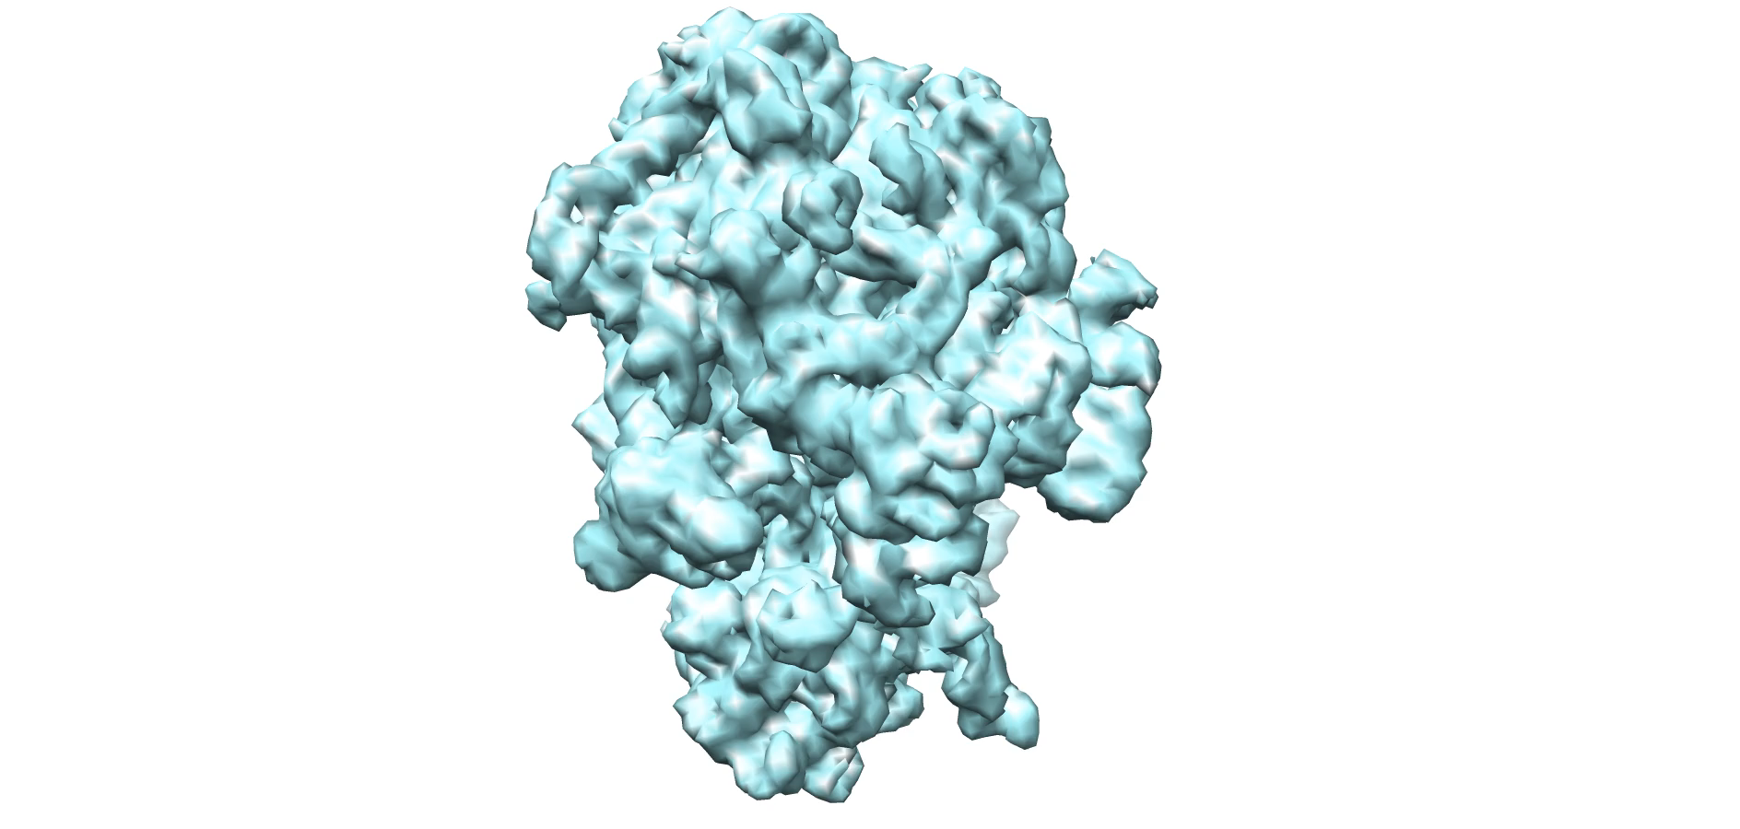
3D continuous conformation analysis [5]
P-site tRNA
50S
E-site tRNA
EF-G
30S

Slide 5
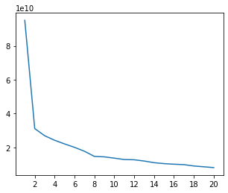
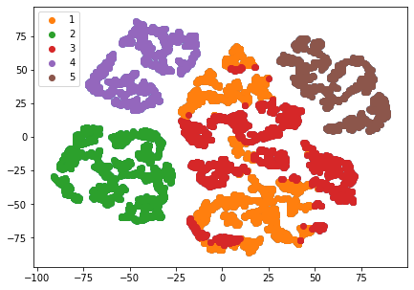
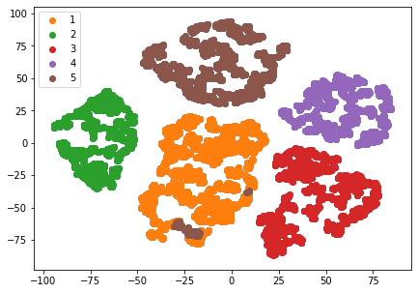
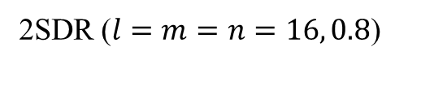
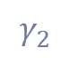
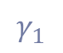
Eigen-Analysis - PCA vs 2SDR
SNR (direct/resample) | impurity | C-impurity
PCA | 0/0.1995 | 0/0.2413
2SDR | 0/0.0106 | 0/0.0106
11000 resampled volumes from clean data
Project each image on to eigenvolumes
2SDR ($l=m=n=16, 0.8$)
PCA
$$γ_{1}$$
eigenvalue
$$γ_{2}$$
eigenvector

Slide 6
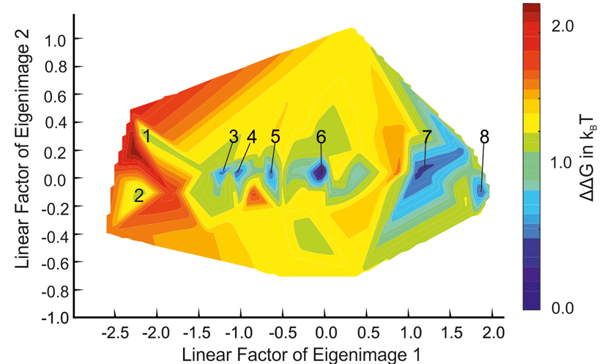
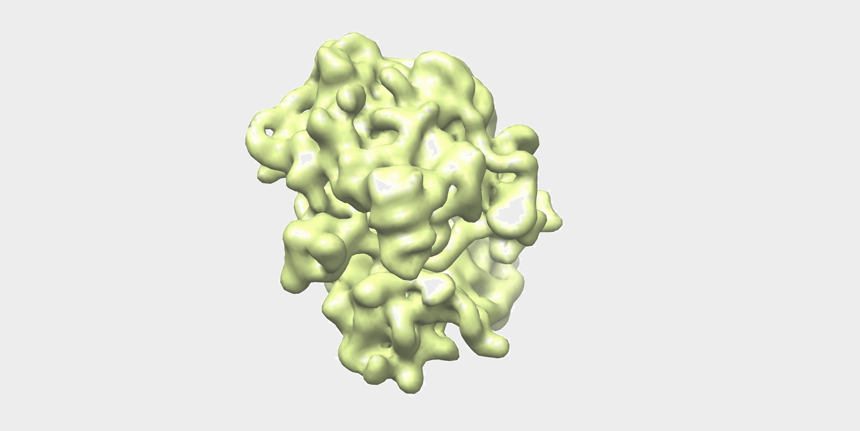
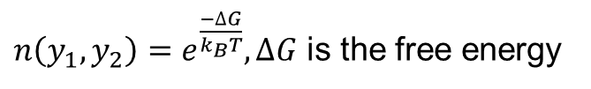
Eigen-Analysis
The low dimensional space learned by projection or manifold learning can be related to energy landscape [6,7]
$n\left(y_{1},y_{2}\right)=e^{\frac{−∆G}{k_{B}T}},∆G$ is the free energy

Slide 7
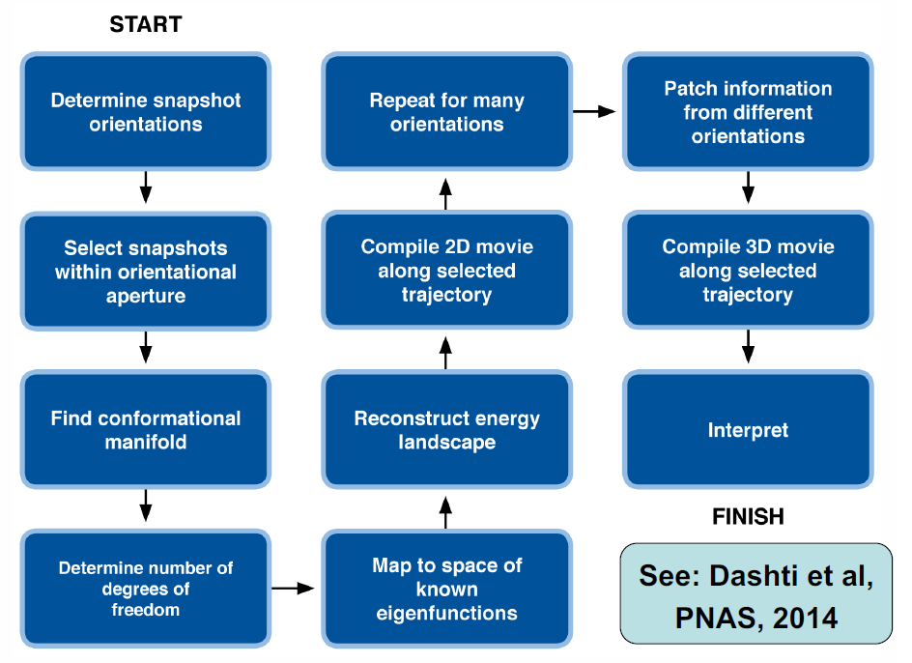
ManifoldEM [8,9]
Diffusion Map
NLSA

Slide 8
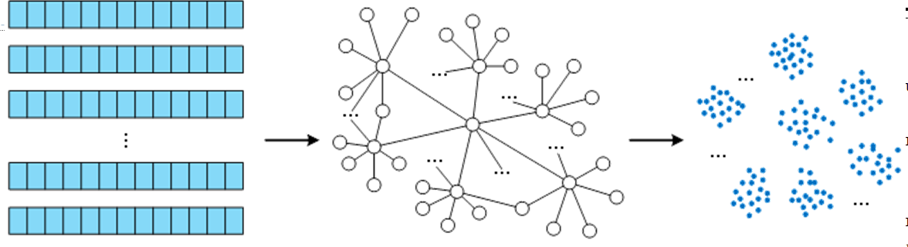
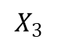
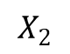
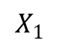
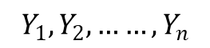
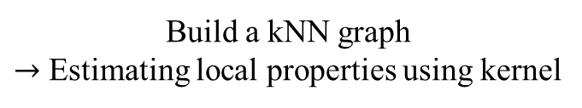
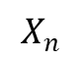
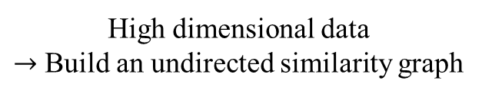
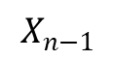
Graph-Based Algorithm For Embedding
$$Y_{1}, Y_{2},……, Y_{n}$$
$$X_{1}$$
$$X_{2}$$
$$X_{3}$$
$$X_{n−1}$$
$$X_{n}$$
High dimensional data
$→$ Build an undirected similarity graph
Build a kNN graph
$→$ Estimating local properties using kernel
Derive global embedding that
keeps local properties
Notes:
k-nearest neighbor (kNN) graphs combine both worlds by connecting each vertex only to
its k-nearest neighbors. If one needs a symmetric weight matrix one may either ignore the
asymmetry of the neighborhood relation by adding an edge in both directions or only include
mutual neighbors.
Similarity graph also called adjacency graph, if it only indicates an edge by binary values.

Slide 9
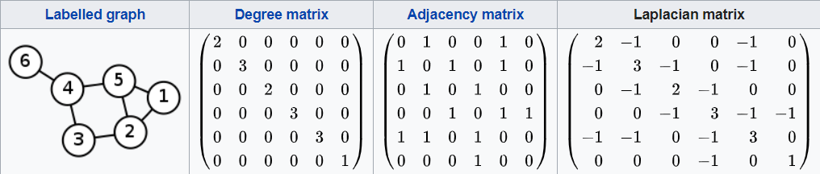
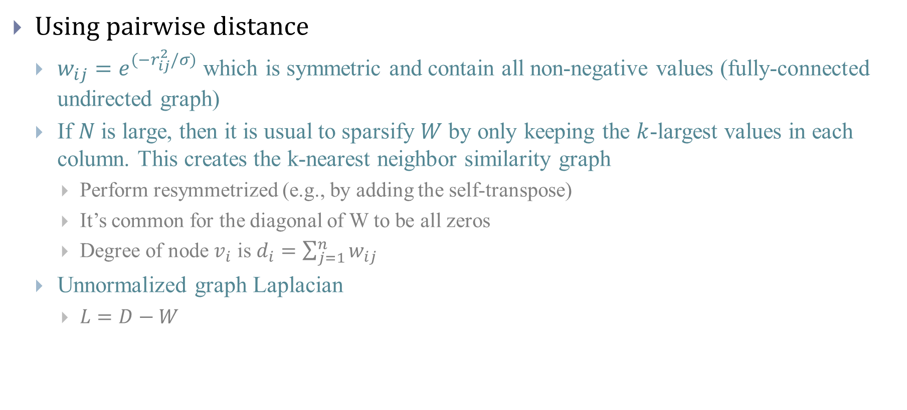
Construct weight matrix
Using pairwise distance
$w_{ij}=e^{(−r_{ij}^{2}/σ)}$ which is symmetric and contain all non-negative values (fully-connected undirected graph)
If $N$is large, then it is usual to sparsify $W$ by only keeping the $k$-largest values in each column. This creates the k-nearest neighbor similarity graph
Perform resymmetrized (e.g., by adding the self-transpose)
It’s common for the diagonal of W to be all zeros
Degree of node $v_{i}$ is $d_{i}=\sum_{j=1}^{n}{w_{ij}}$
Unnormalized graph Laplacian
$L=D−W$

Slide 10
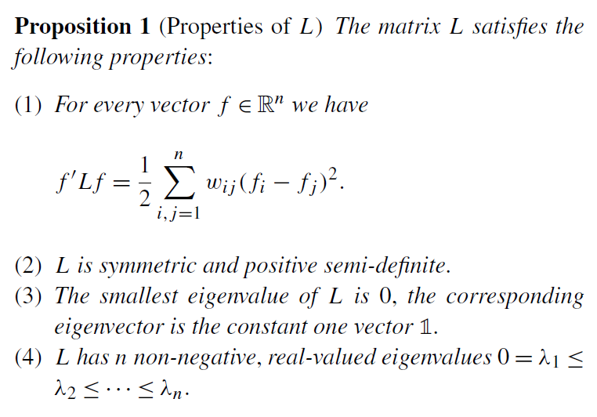
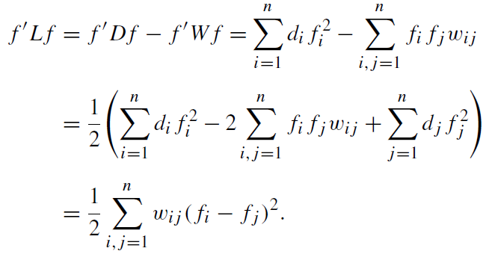
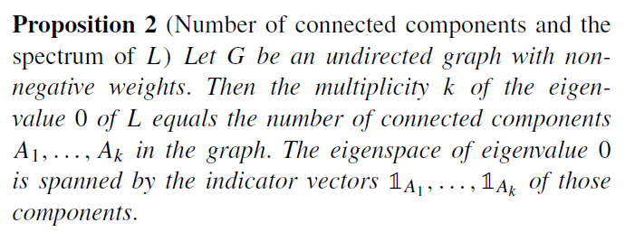
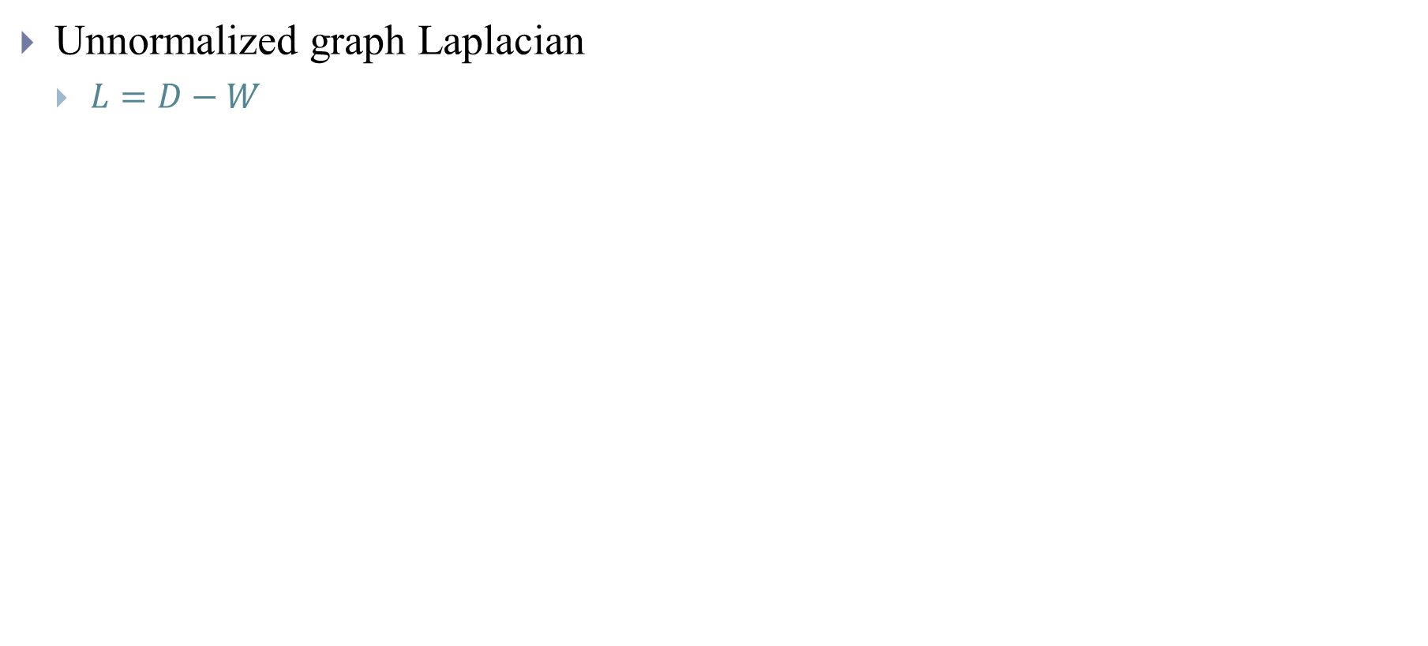
Graph Laplacian [10]
Unnormalized graph Laplacian
$L=D−W$
Notes:
Number of connected component and spectrum of L
L is a matrix representation of a graph, spanning tree, embedding, cut…

Slide 11
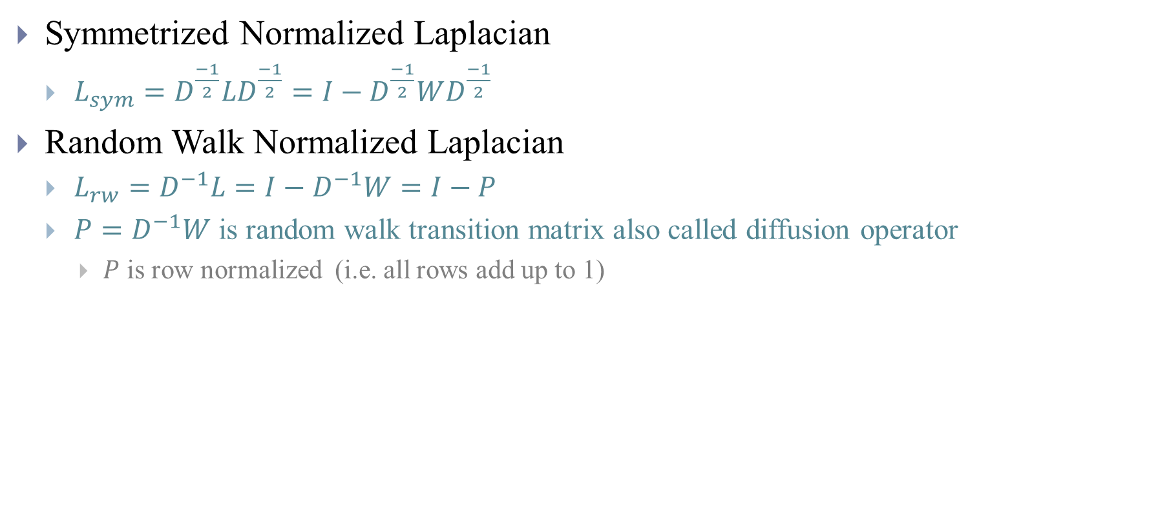
Graph Laplacian [10]
Symmetrized Normalized Laplacian
$L_{sym}=D^{\frac{−1}{2}}LD^{\frac{−1}{2}}=I−D^{\frac{−1}{2}}WD^{\frac{−1}{2}}$
Random Walk Normalized Laplacian
$L_{rw}=D^{−1}L=I−D^{−1}W=I−P$
$P=D^{−1}W$ is random walk transition matrix also called diffusion operator
$P$ is row normalized (i.e. all rows add up to 1)

Slide 12
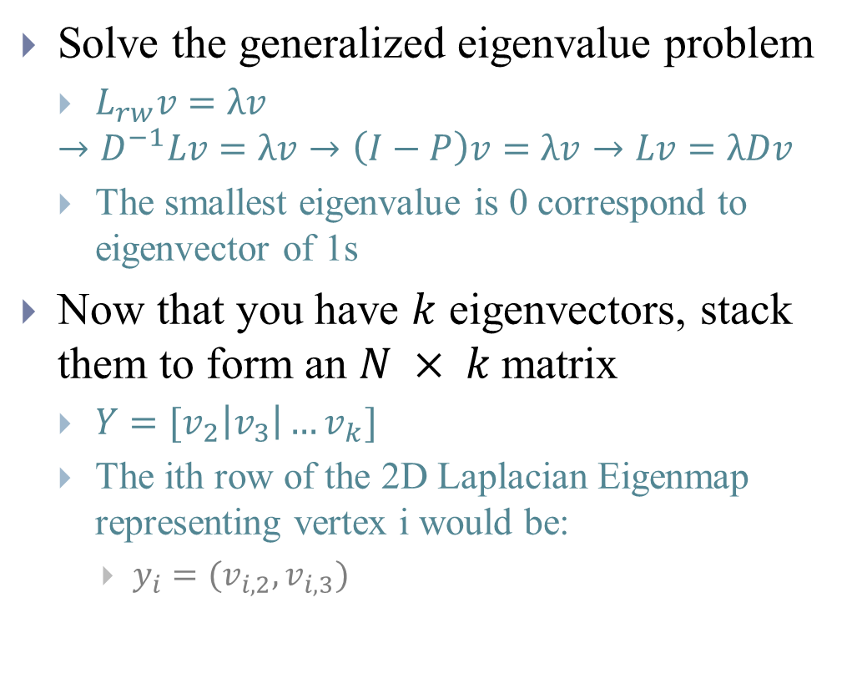
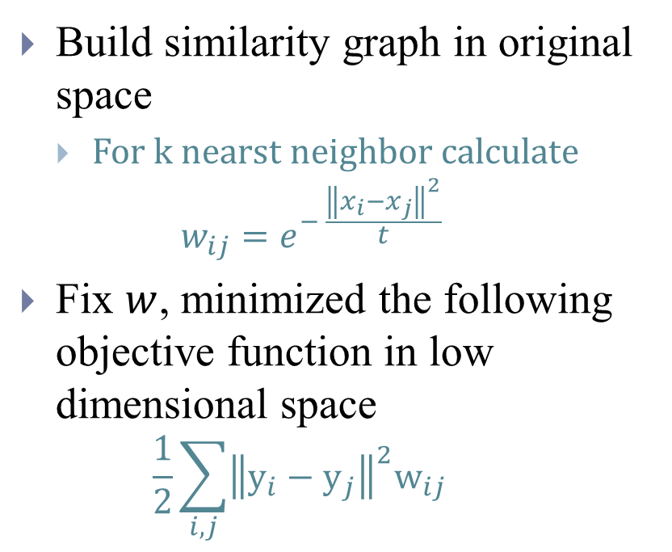
Laplacian Eigenmaps [11]
Solve the generalized eigenvalue problem
$L_{rw}v=λv$
$$→D^{−1}Lv=λv→\left(I−P\right)v=λv→Lv=λDv$$
The smallest eigenvalue is 0 correspond to eigenvector of 1s
Now that you have $k$ eigenvectors, stack them to form an $N × k$matrix
$Y=[v_{2}\left|v_{3}\right|…v_{k}]$
The ith row of the 2D Laplacian Eigenmap representing vertex i would be:
$y_{i}=(v_{i,2},v_{i,3})$
Build similarity graph in original space
For k nearst neighbor calculate
$$w_{ij}=e^{− \frac{{\left\|x_{i}−x_{j}\right\|}^{2}}{t}}$$
Fix $w$, minimized the following objective function in low dimensional space
$$\frac{1}{2}\sum_{i,j}{{\left\|y_{i}−y_{j}\right\|}^{2}w_{ij}}$$
Notes:
Where we constrained one degree of freedom by the additional constraint in order to remove an arbitrary scaling in the embedding. The larger dii, the more edges vertex i has and the more
important it becomes for the minimization. ytDy=1 -> generalized eigenvalue problem
Spectral clustering on the un-normalized graph Laplacian has some undesirable properties, so use one of the normalized Laplacians for clustering
Use either $L_{rw}$ (Laplacian Eigenmaps) or $L_{sym}$
You could even use the eigenvectors of P, although you have to bear in mind that the eigenvalues of P differ from Lrw although in that case the order of the eigenvectors are reversed, i.e. you want those associated with the largest eigenvalues, ignoring the top eigenvector (which is the constant eigenvector). P might even be preferable because it’s ever-so-slightly less work to calculate than Lrw. We’ll revisit the relationship between Lrw and P when we talk about diffusion maps. If you want to reduce dimensions, use the second-smallest and third-smallest eigenvectors...
The Laplacian Eigenmap paper demonstrates a connection between LE and LLE, in that LLE is approximately computing the eigenvectors of L^2, which has the same eigenvectors as L (and the square of the eigenvalues).

Slide 13
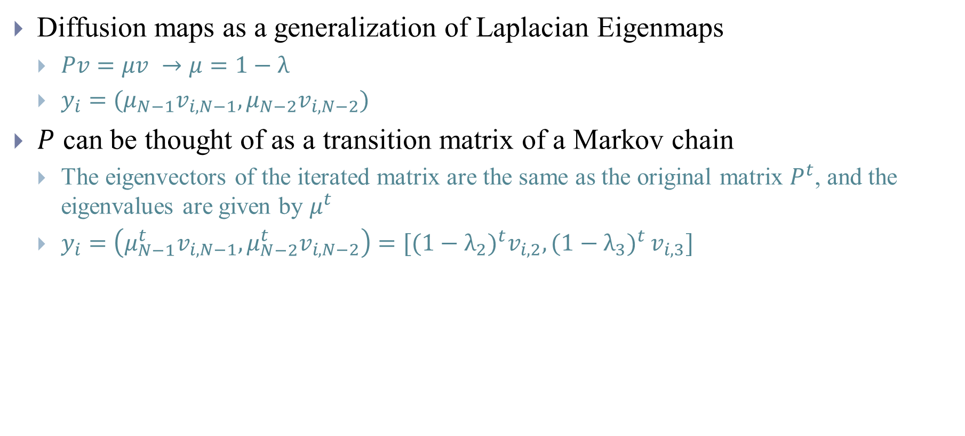
Diffusion Maps [12,13]
Diffusion maps as a generalization of Laplacian Eigenmaps
$Pv=μv →μ=1−λ$
$y_{i}=({μ_{N−1}v}_{i,N−1},{μ_{N−2}v}_{i,N−2})$
$P$ can be thought of as a transition matrix of a Markov chain
The eigenvectors of the iterated matrix are the same as the original matrix $P^{t}$, and the eigenvalues are given by $μ^{t}$
$y_{i}=\left({μ_{N−1}^{t}v}_{i,N−1},{μ_{N−2}^{t}v}_{i,N−2}\right)=[{(1−λ_{2})}^{t}v_{i,2}{,(1−λ_{3})}^{t}v_{i,3}]$
Notes:
Laplacian Eigenmaps are a special case of diffusion maps. This special case handles only manifolds from which the data is sampled uniformly
In diffusion maps, you keep the top eigenvectors ignoring the very top eigenvector. Because of the relationship between Lrw and P, it turns out that you still end up using the same eigenvectors for diffusion maps as you do for Laplacian Eigenmaps, just the ordering is reversed. Because the values of λ are in increasing order, this makes it easier to see that the effect of $t$ is to relatively upweight the contribution of later eigenvectors in determining the distance between points on the map
where vN is the uninteresting top eigenvector of all 1s (and μN=1).
Because you can evaluate the probabilities at time step t by creating the iterated matrix Pt, you can get a sense of the geometry of the data at different scales by seeing how the probability changes over time.
In such a framework, a cluster is a region in which the probability of escaping this region is low

Slide 14
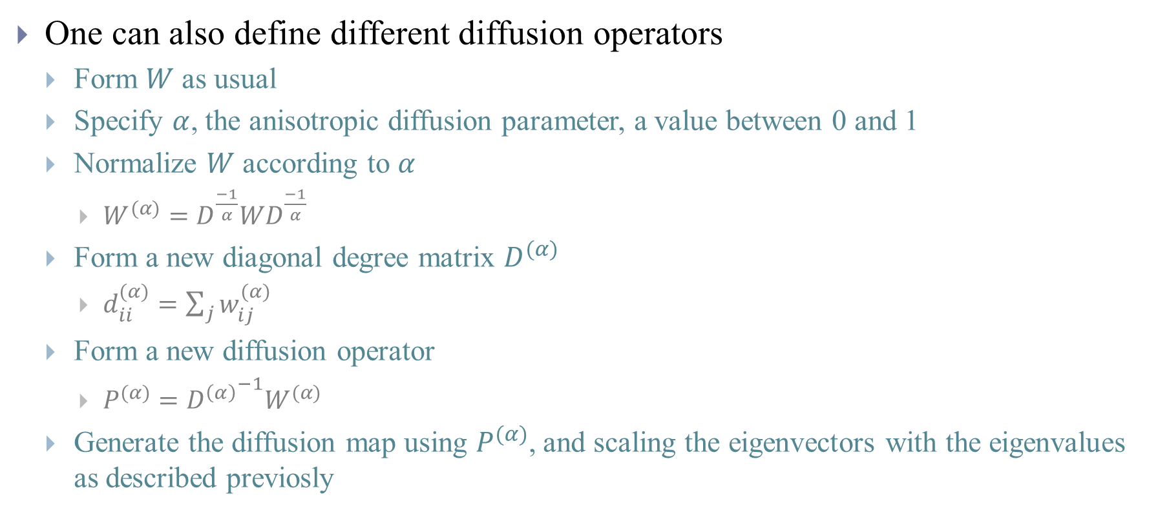
Anisotropic Diffusion
One can also define different diffusion operators
Form $W$ as usual
Specify $α$, the anisotropic diffusion parameter, a value between 0 and 1
Normalize $W$ according to $α$
$W^{(α)}=D^{\frac{−1}{α}}WD^{\frac{−1}{α}}$
Form a new diagonal degree matrix $D^{(α)}$
$d_{ii}^{(α)}=\sum_{j}{w_{ij}^{(α)}}$
Form a new diffusion operator
$P^{(α)}={D^{\left(α\right)}}^{−1}W^{(α)}$
Generate the diffusion map using $P^{(α)}$, and scaling the eigenvectors with the eigenvalues as described previosly
Notes:
When α=0 you get back the diffusion map based on the random walk-style diffusion operator (and Laplacian Eigenmaps). For α=1, the diffusion operator approximates the Laplace-Beltrami operator and for α=0.5, you get Fokker-Planck diffusion.
For = 0, we get the random walk Laplacian as before. The interesting case arises for = 1, where the influence of the distribution no longer influences the embedding and the geometry of the dataset may be recovered
In the paper, Nadler et. al. showed how to design a kernel that reproduces the diffusion induced by a Fokker–Planck equation. Also, they explained that, when the data approximate a manifold, one can recover the geometry of this manifold by computing an approximation of the Laplace–Beltrami operator.

Slide 15
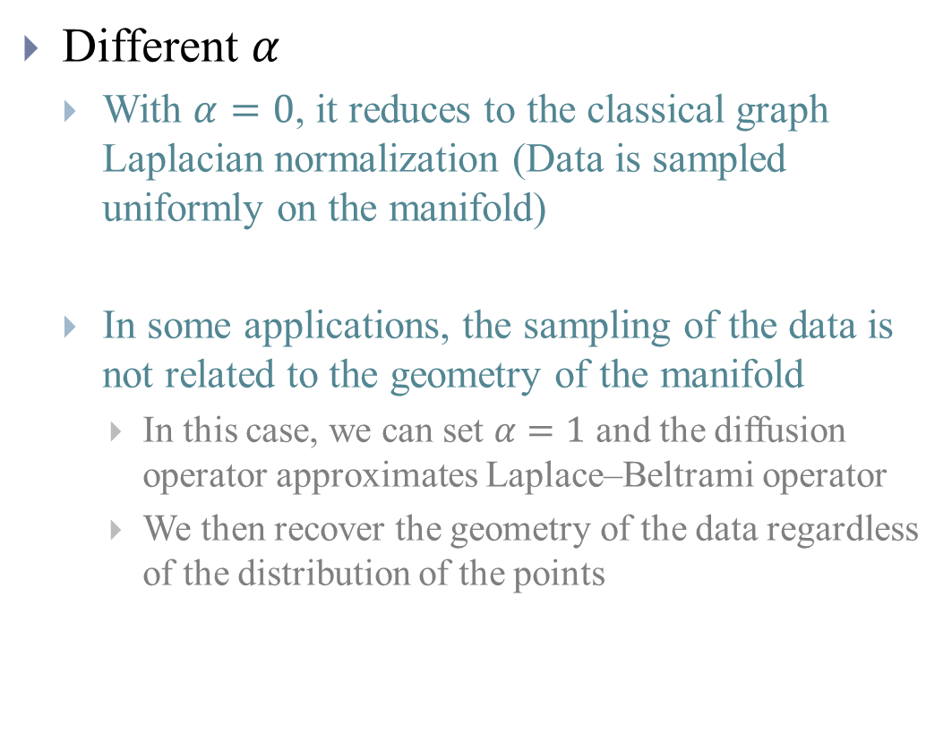
Anisotropic Diffusion
Different $α$
With $α=0$, it reduces to the classical graph Laplacian normalization (Data is sampled uniformly on the manifold)
In some applications, the sampling of the data is not related to the geometry of the manifold
In this case, we can set $α=1$ and the diffusion operator approximates Laplace–Beltrami operator
We then recover the geometry of the data regardless of the distribution of the points
Notes:
The reason to introduce the normalization step involving $α$ is to tune the influence of the data point density on the infinitesimal transition of the diffusion
To describe the long-term behavior of the point distribution of a system of stochastic differential equations, we can use $α=0.5$and the resulting Markov chain approximates the Fokker–Planck diffusion
The Laplace operator is a differential operator defined as the divergence of the gradient. It is defined in the n-dimensional Euclidean space
Laplace-Beltrami operator is an extension of normal Laplacians to manifolds.

Slide 16
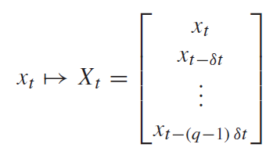
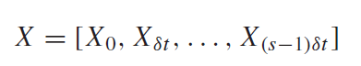
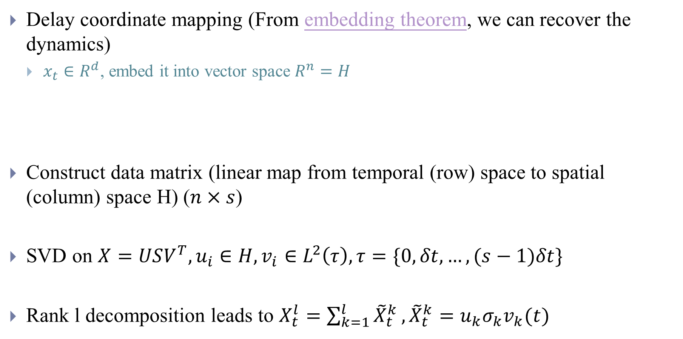
Singular Spectrum Analysis [14]
Delay coordinate mapping (From embedding theorem, we can recover the dynamics)
$x_{t}∈R^{d}$, embed it into vector space $R^{n}$ $=H$
Construct data matrix (linear map from temporal (row) space to spatial (column) space H) ($n×s$)
SVD on $X=USV^{T}, u_{i}∈H,v_{i}∈L^{2}\left(τ\right),τ=\{0, δt,…,(s−1)δt\}$
Rank l decomposition leads to $X_{t}^{l}=\sum_{k=1}^{l}{{\tilde{X}}_{t}^{k}},{\tilde{X}}_{t}^{k}=u_{k}σ_{k}v_{k}(t)$
Spatial modes
Temporal modes
Notes:
where $X_{t}$ lines on a manifold $M$ (Temporal patterns)
Sampled uniformly with time stamp $δt$
https://github.com/aj-cloete/pssa/blob/master/Singular%20Spectrum%20Analysis%20Example.ipynb

Slide 17
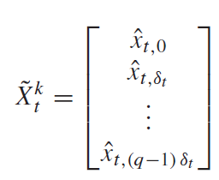
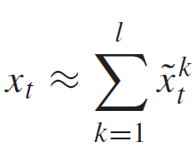
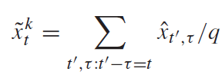
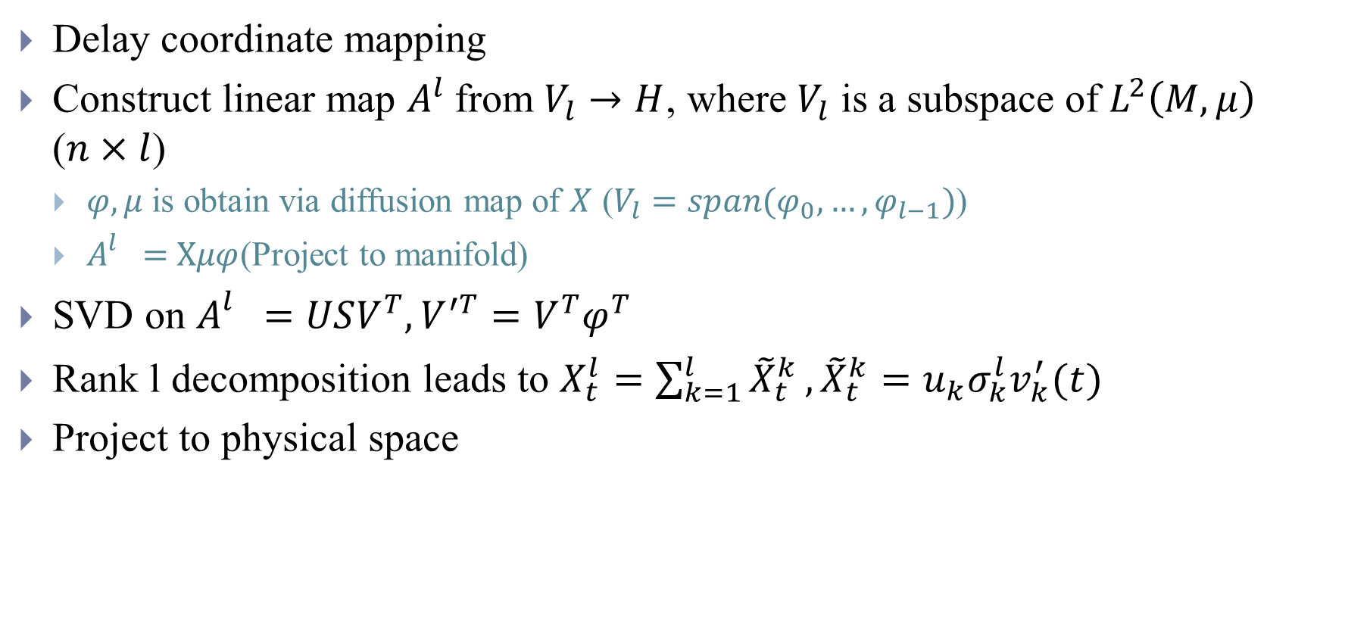
Nonlinear Laplacian Spectrum Analysis [15]
Delay coordinate mapping
Construct linear map $A^{l}$from $V_{l}→H$, where $V_{l}$ is a subspace of $L^{2}\left(M,μ\right)$ ($n×l$)
$φ, μ$ is obtain via diffusion map of $X$ ($V_{l}=span(φ_{0},…,φ_{l−1})$)
$A_{}^{l}=$ $Xμφ$(Project to manifold)
SVD on $A_{}^{l}=USV^{T}, V^{′T}=V^{T}φ^{T}$
Rank l decomposition leads to $X_{t}^{l}=\sum_{k=1}^{l}{{\tilde{X}}_{t}^{k}},{\tilde{X}}_{t}^{k}=u_{k}σ_{k}^{l}v_{k}^{′}(t)$
Project to physical space
Notes:
$$n×l$$
Column averages
$$\sum_{t∈τ}{μ\left(X_{t}\right)}φ_{j}\left(X_{t}\right)X_{it}$$
$$A_{ij}^{l}=\sum_{k=1}^{r}{u_{ik}σ_{k}^{l}v_{jk}}, r=\min\left\{l,n\right\},v_{k}\left(t\right)=\sum_{i=1}^{l}{v_{ik}φ_{i−1}(X_{t})}$$

Slide 18
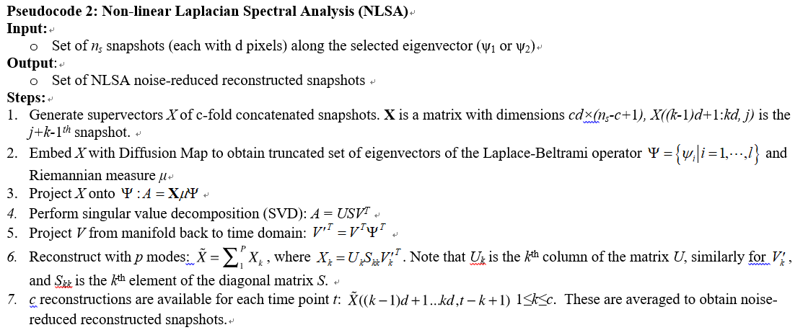
Nonlinear Laplacian Spectrum Analysis
Notes:
$μ=Pμ$ which can be calculated using degree matrix

Slide 19
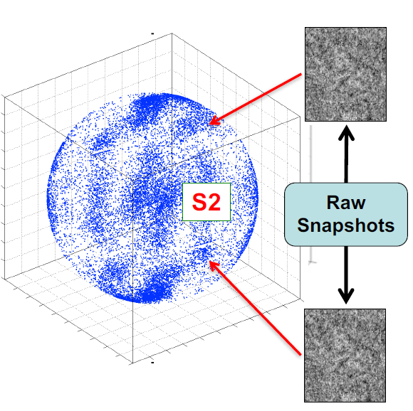
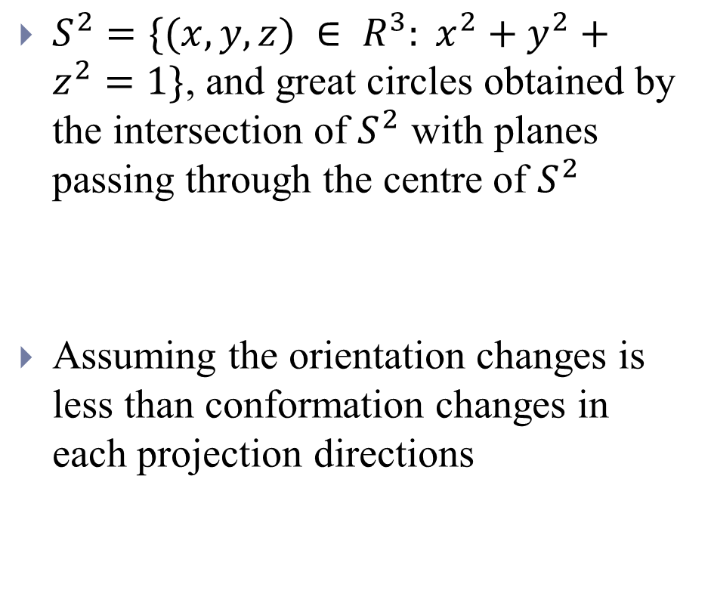
ManifoldEM - Tessellation
$S^{2}=\{(x, y, z) ∈ R^{3}: x^{2}+y^{2}+z^{2}=1\}$, and great circles obtained by the intersection of $S^{2}$ with planes passing through the centre of $S^{2}$
Assuming the orientation changes is less than conformation changes in each projection directions
Notes:
https://en.wikipedia.org/wiki/N-sphere
Shannon angle $\frac{Res}{Diameter of molecule}$

Slide 20
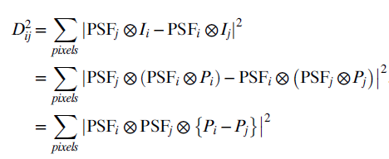
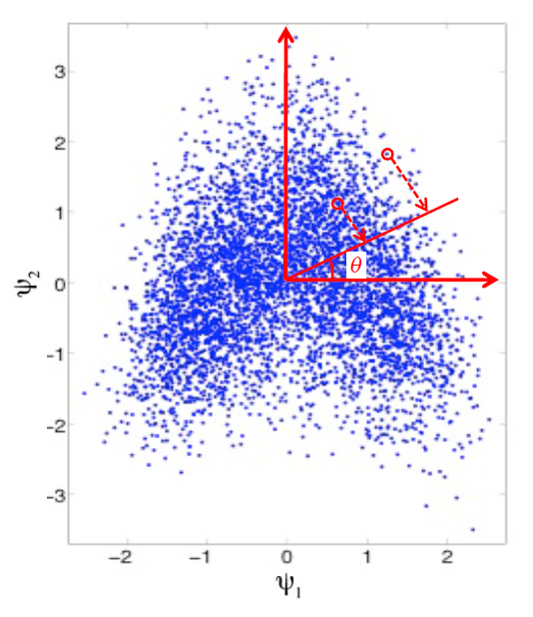
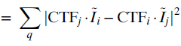
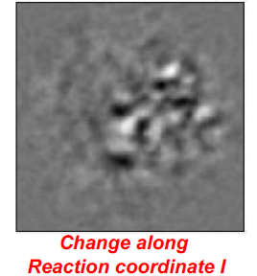
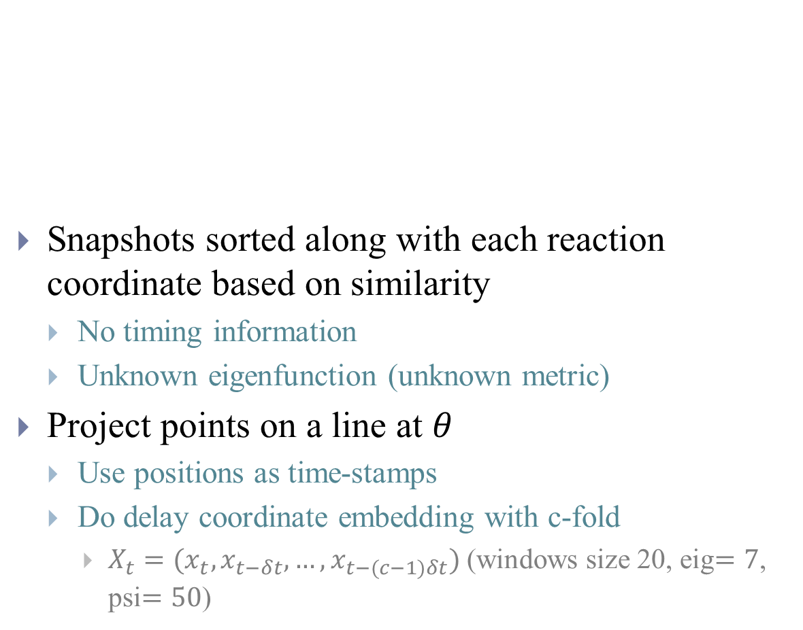
ManifoldEM - Defocus-tolerant kernel for diffusion map
Snapshots sorted along with each reaction coordinate based on similarity
No timing information
Unknown eigenfunction (unknown metric)
Project points on a line at $θ$
Use positions as time-stamps
Do delay coordinate embedding with c-fold
$X_{t}=(x_{t},x_{t−δt},…,x_{t−(c−1)δt})$ (windows size 20, eig$=7$, psi$=50$)
Make 2D movie using NLSA
reconstructed snapshot

Slide 21






ManifoldEM - NLSA to extract $τ$ for each snapshots
NLSA
Diffusion map on reconstructed snapshots produce 1D manifold characterized by $τ(θ)$
If data lies on 1D manifold (due to projection), it can be described using known eigenfunction$φ_{k}=\sqrt{2}\cos{(kπτ)}, k=1,2…$ for each snapshot
Lies in 1D manifold?
$$φ_{3}$$
$$φ_{2}$$
$$φ_{1}$$

Slide 22


ManifoldEM – Tomographic Reconstruction from Manifold of all projections
Conformation parameter$τ$ allows a consistent approach to reconstruct the energy landscape
$n\left(τ,θ\right)$ can be computed from $τ(θ)$
The density of points $n(τ,θ)$ on the 1D manifold is the Radom transform of the embedded data cloud in diffusion maps
$n\left(τ,θ\right)=e^{\frac{−∆G}{k_{B}T}},∆G$ is the free energy
Notes:
Assume same conformational spectrum observed in all PDs
Reasonable, since same system is being viewed in all PDs
Remove metric inhomogeneity by equalizing histograms
In different projection directions
Universal parameterization of conformational metric
Polar coordinate
with ΔG denoting the change in the
Gibbs free energy, kB the Boltzmann constant, and T the temperature.

Slide 23



Problems (https://franklab.cpmc.columbia.edu/franklab/archives/24187)
When merging information from all projection directions [16]
The order of eigenvalue may be different and sign may be reversed (The obtained movie is revere)…
Optical flow, HOG, Belief propagation
Find the possible paths on the energy landscape [17]
Other methods can also produce energy landscape
MEPSA, string…
Simulation data generation [18]
Notes:
Ensure that we are summing over corresponding conformation occupancies from all PDs
Propogation of coordinate across angular space is an issue

Slide 24
References
[1] Nakane, T., Kotecha, A., Sente, A. et al. “Single-particle cryo-EM at atomic resolution”. Nature 587, 152–156 (2020).
[2] https://deepmind.com/blog/article/alphafold-a-solution-to-a-50-year-old-grand-challenge-in-biology
[3] https://www.blopig.com/blog/2020/12/casp14-what-google-deepminds-alphafold-2-really-achieved-and-what-it-means-for-protein-folding-biology-and-bioinformatics/
[4] https://moalquraishi.wordpress.com/2020/12/08/alphafold2-casp14-it-feels-like-ones-child-has-left-home/#s4.1
[5] Penczek, Pawel A., Marek Kimmel, and Christian MT Spahn. "Identifying conformational states of macromolecules by eigen-analysis of resampled cryo-EM images." Structure 19.11 (2011): 1582-1590.
[6] Haselbach, David, et al. (2018) “Structure and conformational dynamics of the human spliceosomal Bact complex.” Cell 172.3, 454-464.
[7] Zhaolong Wu, Shuwen Zhang, Wei Li Wang, Yinping Ma, Yuanchen Dong and Youdong Mao
“Deep manifold learning reveals hidden dynamics of proteasome autoregulation” bioRxiv 2020.
[8] Dashti, Ali, et al. "Trajectories of the ribosome as a Brownian nanomachine." Proceedings of the National Academy of Sciences 111.49 (2014): 17492-17497.
[9] Dashti, Ali, et al. "Retrieving functional pathways of biomolecules from single-particle snapshots." Nature communications 11.1 (2020): 1-14. https://github.com/GMashayekhi/ManifoldEM_Matlab
[10] Von Luxburg, Ulrike. "A tutorial on spectral clustering." Statistics and computing 17.4 (2007): 395-416.

Slide 25
References
[11] Mikhail Belkin and Partha Niyogi, “Laplacian eigenmaps for dimensionality reduction and data representation”, Neural Comput. 15 (2003), no. 6, 1373–1396.
[12] https://jlmelville.github.io/smallvis/spectral.html
[13] Socher, Richard, and Matthias Hein. "Manifold learning and dimensionality reduction with diffusion maps." Seminar report, Saarland University. 2008.
[14] Golyandina, Nina, and Anatoly Zhigljavsky. "Basic SSA." Singular Spectrum Analysis for Time Series. Springer, Berlin, Heidelberg, 2020. 21-90.
[15] Giannakis, Dimitrios, and Andrew J. Majda. "Nonlinear Laplacian spectral analysis: capturing intermittent and low‐frequency spatiotemporal patterns in high‐dimensional data." Statistical Analysis and Data Mining: The ASA Data Science Journal 6.3 (2013): 180-194.
[16] Maji, Suvrajit, et al. "Propagation of Conformational Coordinates Across Angular Space in Mapping the Continuum of States from Cryo-EM Data by Manifold Embedding." Journal of Chemical Information and Modeling (2020). https://github.com/suvrajitm/ConformationalCoordPropagation
[17] Seitz, Evan, and Joachim Frank. "POLARIS: path of least action analysis on energy landscapes." Journal of Chemical Information and Modeling 60.5 (2020): 2581-2590. https://github.com/evanseitz/POLARIS
[18] Seitz, Evan, et al. "Simulation of cryo-EM ensembles from atomic models of molecules exhibiting continuous conformations." BioRxiv (2019): 864116. https://github.com/evanseitz/cryoEM_synthetic_generation

Slide 26

Geodistance
Notes:
We assume that, in a small neighbourhood (determined by K-nearest neighbours or points within a specified radius), the Euclidean distance is a good approximation
for the geodesic distance.
For points further apart, the geodesic distance is approximated as the sum of Euclidean distances along the shortest connecting path.

Slide 27

Diffusion Distance
Relate to diffusion distance
Diffusion Map

Slide 28

ManifoldEM - Integrating into 3D
Integrate 2D conformational information into 3D
Using information from all projection directions
Perform 3D reconstructions on the energy landscape

